Slide 1
Computer Vision and Deep Learning
Lecture 3

Slide 2
Last time – linear classification
Score function: to map inputs (images) to class scores
Loss function: to evaluate a classifier
Hinge loss
Softmax loss
Optimization
Classifier evaluation

Slide 3
Today’s agenda
Computational graphs
Backpropagation
Artificial neural networks
Activation functions
Image convolutions (one step forward towards convolutional neural networks)

Slide 4
Recap Linear classifier
Linear classifiers are defined by parameters (consisting of weights and biases
Their training happens in two steps:
Forward Propagation: It runs the input data through the score function to make its best guess about the correct output.
Backward Propagation: adjusts its parameters proportionate to the error in its guess.
Traverse backwards from the output, collecting the derivatives of the error with respect to the parameters of the functions (gradients), and optimizing the parameters using gradient descent.

Slide 5
How do we compute the gradients?
Numerical gradient
Analytical gradient
Better idea: use computational graphs and back-propagation

Slide 6
Computational graphs
f(a, b, c) = a*b + c
a
*
b
+
f
c

Slide 7
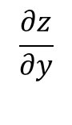
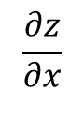
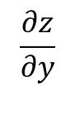
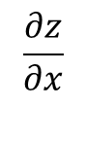
Back propagation
x
f
$$\frac{∂z}{∂x}$$
z
$$\frac{∂z}{∂y}$$
y
$$\frac{∂z}{∂x}$$
$$\frac{∂z}{∂y}$$
Local gradients
Influence of x and y on the nodes output z

Slide 8
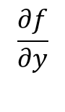
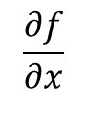
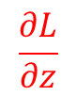
Back propagation
x
f
$$\frac{∂f}{∂x}$$
z
$$\frac{∂f}{∂y}$$
$$\frac{∂L}{∂z}$$
Influence of z to the final output of the graph (loss)
y

Slide 9
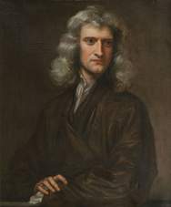
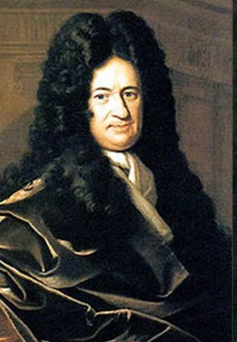

Back propagation
Chain rule $\frac{∂f}{∂a}=\frac{∂f}{∂b}\frac{∂b}{∂z}$
x
f
$$\frac{∂f}{∂x}$$
z
$$\frac{∂f}{∂y}$$
$$\frac{∂L}{∂z}$$
Influence of z to the final output of the graph (loss)
y

Slide 10
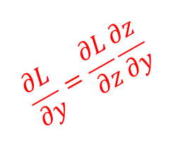
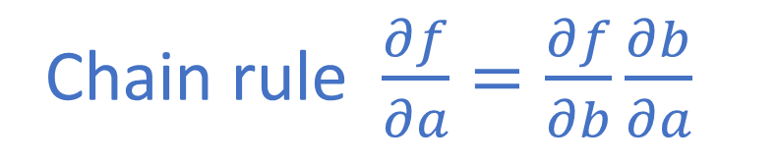
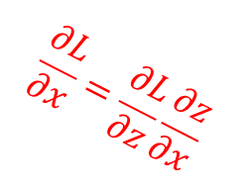
Back propagation
Chain rule $\frac{∂f}{∂a}=\frac{∂f}{∂b}\frac{∂b}{∂a}$
x
$$\frac{∂L}{∂x}=\frac{∂L}{∂z}\frac{∂z}{∂x}$$
f
$$\frac{∂z}{∂x}$$
z
$$\frac{∂z}{∂y}$$
$$\frac{∂L}{∂z}$$
$$\frac{∂L}{∂y}=\frac{∂L}{∂z}\frac{∂z}{∂y}$$
Influence of z to the final output of the graph (loss)
y

Slide 11
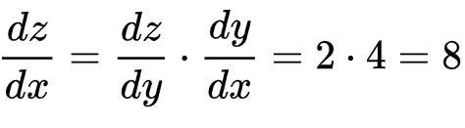
Chain rule
Knowing the instantaneous rate of change of z relative to y and that of y relative to x allows one to calculate the instantaneous rate of change of z relative to x as the product of the two rates of change
"If a car travels twice as fast as a bicycle and the bicycle is four times as fast as a walking man, then the car travels 2 × 4 = 8 times as fast as the man.„
Let z, y and x be the (variable) positions of the car, the bicycle, and the walking man, respectively.
https://en.wikipedia.org/wiki/Chain_rule

Slide 12
Back propagation
Use a recursive application of the chain rule on every node in the graph to computer influence of all the intermediate nodes on the output of the graph

Slide 13
Computational graphs – forward pass
f(a, b, c) = a*b + c
3
a = 3
b = 4
c = -4
a
*
12
4
b
+
f
8
-4
c

Slide 14
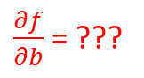
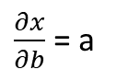
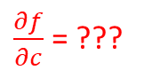
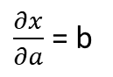
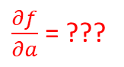
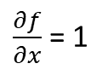
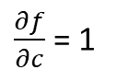
Computational graphs – backward pass
Go backward, from the end of the computational graph, and compute the gradient for each node in the graph
3
f(a, b, c) = a*b + c
a
$\frac{∂x}{∂a}$ = b
*
x
x = a*b
12
$\frac{∂x}{∂b}$ = a
4
b
+
f
8
$\frac{∂f}{∂c}$ = 1
f = x + c
$\frac{∂f}{∂x}$ = 1
-4
c
$\frac{∂f}{∂a}$ = ???
$\frac{∂f}{∂b}$ = ???
$\frac{∂f}{∂c}$ = ???

Slide 15
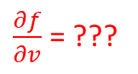
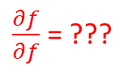
Computational graphs – backward pass
Go backward, from the end of the computational graph, and compute the gradient for each node in the graph
3
f(a, b, c) = a*b + c
a
$\frac{∂x}{∂a}$ = b
*
x
x = a*b
12
$\frac{∂x}{∂b}$ = a
4
b
+
f
8
$\frac{∂f}{∂c}$ = 1
$\frac{∂f}{∂f}$ = ???
f = x + c
$\frac{∂f}{∂x}$ = 1
-4
c
$\frac{∂f}{∂a}$ = ???
$\frac{∂f}{∂b}$ = ???
$\frac{∂f}{∂v}$ = ???

Slide 16
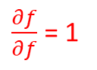
Computational graphs – backward pass
Go backward, from the end of the computational graph, and compute the gradient for each node in the graph
3
f(a, b, c) = a*b + c
a
$\frac{∂x}{∂a}$ = b
*
x
x = a*b
12
$\frac{∂x}{∂b}$ = a
4
b
+
f
8
$\frac{∂f}{∂c}$ = 1
$\frac{∂f}{∂f}$ = 1
f = x + c
$\frac{∂f}{∂x}$ = 1
-4
c
$\frac{∂f}{∂a}$ = ???
$\frac{∂f}{∂b}$ = ???
$\frac{∂f}{∂v}$ = ???

Slide 17
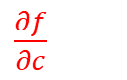
Computational graphs – backward pass
Go backward, from the end of the computational graph, and compute the gradient for each node in the graph
3
f(a, b, c) = a*b + c
a
$\frac{∂x}{∂a}$ = b
*
x
x = a*b
12
$\frac{∂x}{∂b}$ = a
4
b
+
f
8
$\frac{∂f}{∂c}$ = 1
1
f = x + c
$\frac{∂f}{∂x}$ = 1
-4
c
$\frac{∂f}{∂c}$
$\frac{∂f}{∂a}$ = ???
$\frac{∂f}{∂b}$ = ???
$\frac{∂f}{∂v}$ = ???

Slide 18
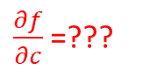
Computational graphs – backward pass
Go backward, from the end of the computational graph, and compute the gradient for each node in the graph
3
f(a, b, c) = a*b + c
a
$\frac{∂x}{∂a}$ = b
*
x
x = a*b
12
$\frac{∂x}{∂b}$ = a
4
b
+
f
8
$\frac{∂f}{∂c}$ = 1
1
f = x + c
$\frac{∂f}{∂x}$ = 1
-4
c
$\frac{∂f}{∂c}$=???
$\frac{∂f}{∂a}$ = ???
$\frac{∂f}{∂b}$ = ???
$\frac{∂f}{∂v}$ = ???

Slide 19
Computational graphs – backward pass
Go backward, from the end of the computational graph, and compute the gradient for each node in the graph
3
f(a, b, c) = a*b + c
a
$\frac{∂x}{∂a}$ = b
*
x
x = a*b
12
$\frac{∂x}{∂b}$ = a
4
b
+
f
8
$\frac{∂f}{∂c}$ = 1
1
f = x + c
$\frac{∂f}{∂x}$ = 1
-4
c
1
$\frac{∂f}{∂a}$ = ???
$\frac{∂f}{∂b}$ = ???
$\frac{∂f}{∂v}$ = ???

Slide 20
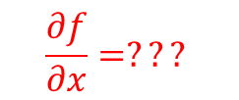
Computational graphs – backward pass
Go backward, from the end of the computational graph, and compute the gradient for each node in the graph
3
f(a, b, c) = a*b + c
a
$\frac{∂x}{∂a}$ = b
*
x
x = a*b
12
$\frac{∂x}{∂b}$ = a
4
b
$$\frac{∂f}{∂x}=???$$
+
f
8
$\frac{∂f}{∂c}$ = 1
1
f = x + c
$\frac{∂f}{∂x}$ = 1
-4
c
1
$\frac{∂f}{∂a}$ = ???
$\frac{∂f}{∂b}$ = ???
$\frac{∂f}{∂v}$ = ???

Slide 21
Computational graphs – backward pass
Go backward, from the end of the computational graph, and compute the gradient for each node in the graph
3
f(a, b, c) = a*b + c
a
$\frac{∂x}{∂a}$ = b
*
x
x = a*b
12
$\frac{∂x}{∂b}$ = a
4
b
$$\frac{∂f}{∂x}=???$$
+
f
8
$\frac{∂f}{∂c}$ = 1
1
f = x + c
$\frac{∂f}{∂x}$ = 1
-4
c
1
$\frac{∂f}{∂a}$ = ???
$\frac{∂f}{∂b}$ = ???
$\frac{∂f}{∂v}$ = ???

Slide 22
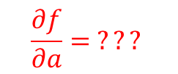

Computational graphs – backward pass
Go backward, from the end of the computational graph, and compute the gradient for each node in the graph
3
f(a, b, c) = a*b + c
a
$\frac{∂x}{∂a}$ = b
$$\frac{∂f}{∂a}= ???$$
*
x = a*b
x
12
$\frac{∂x}{∂b}$ = a
4
$$1$$
b
+
f
8
$\frac{∂f}{∂c}$ = 1
1
f = x + c
$\frac{∂f}{∂x}$ = 1
-4
c
1
$\frac{∂f}{∂a}$ = ???
$\frac{∂f}{∂b}$ = ???
$\frac{∂f}{∂v}$ = ???

Slide 23
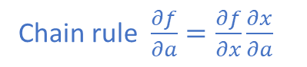
Computational graphs – backward pass
Go backward, from the end of the computational graph, and compute the gradient for each node in the graph
3
Chain rule $\frac{∂f}{∂a}=\frac{∂f}{∂x}\frac{∂x}{∂a}$
f(a, b, c) = a*b + c
a
$\frac{∂x}{∂a}$ = b
$$\frac{∂f}{∂a}= ???$$
*
x = a*b
x
12
$\frac{∂x}{∂b}$ = a
4
$$1$$
b
+
f
8
$\frac{∂f}{∂c}$ = 1
1
f = x + c
$\frac{∂f}{∂x}$ = 1
-4
c
1
$\frac{∂f}{∂a}$ = ???
$\frac{∂f}{∂b}$ = ???
$\frac{∂f}{∂v}$ = ???

Slide 24
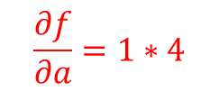
Computational graphs – backward pass
Go backward, from the end of the computational graph, and compute the gradient for each node in the graph
3
Chain rule $\frac{∂f}{∂a}=\frac{∂f}{∂x}\frac{∂x}{∂a}$
f(a, b, c) = a*b + c
a
$\frac{∂x}{∂a}$ = b
$$\frac{∂f}{∂a}=1∗4$$
*
x = a*b
x
12
$\frac{∂x}{∂b}$ = a
4
$$1$$
b
+
f
8
$\frac{∂f}{∂c}$ = 1
1
f = x + c
$\frac{∂f}{∂x}$ = 1
-4
c
1
$\frac{∂f}{∂a}$ = ???
$\frac{∂f}{∂b}$ = ???
$\frac{∂f}{∂v}$ = ???

Slide 25
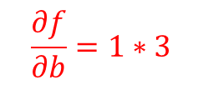

Computational graphs – backward pass
Go backward, from the end of the computational graph, and compute the gradient for each node in the graph
3
Chain rule $\frac{∂f}{∂a}=\frac{∂f}{∂x}\frac{∂x}{∂a}$
f(a, b, c) = a*b + c
a
$\frac{∂x}{∂a}$ = b
$$4$$
*
x = a*b
x
12
$\frac{∂x}{∂b}$ = a
4
$$1$$
b
$$\frac{∂f}{∂b}=1∗3$$
+
f
8
$\frac{∂f}{∂c}$ = 1
1
f = x + c
$\frac{∂f}{∂x}$ = 1
-4
c
1
$\frac{∂f}{∂a}$ = ???
$\frac{∂f}{∂b}$ = ???
$\frac{∂f}{∂v}$ = ???

Slide 26
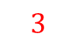
Computational graphs – backward pass
Go backward, from the end of the computational graph, and compute the gradient for each node in the graph
3
Chain rule $\frac{∂f}{∂a}=\frac{∂f}{∂x}\frac{∂x}{∂a}$
f(a, b, c) = a*b + c
a
$\frac{∂x}{∂a}$ = b
$$4$$
*
x = a*b
x
12
$\frac{∂x}{∂b}$ = a
4
$$1$$
b
+
f
8
$$3$$
$\frac{∂f}{∂c}$ = 1
1
f = x + c
$\frac{∂f}{∂x}$ = 1
-4
c
1
$\frac{∂f}{∂a}$ = ???
$\frac{∂f}{∂b}$ = ???
$\frac{∂f}{∂v}$ = ???

Slide 27
Computational graphs – backward pass
Go backward, from the end of the computational graph, and compute the gradient for each node in the graph
3
f(a, b, c) = a*b + c
a
$$4$$
*
x
12
4
$$1$$
b
+
f
8
$$3$$
1
-4
c
1

Slide 28
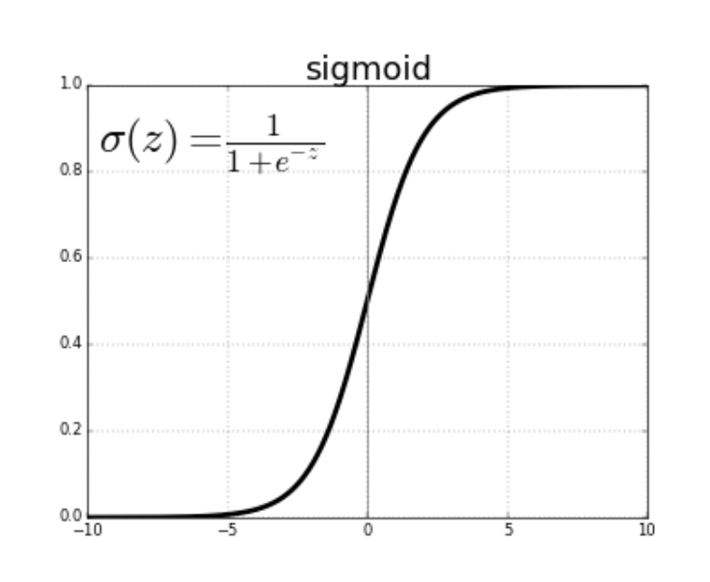
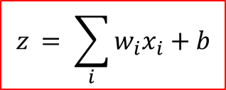
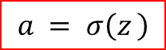
Backprop example with a neural network in mind
In a neural network a neuron computes a linear function, followed by a non-linearity (activation function).
$$z_{ }= \sum_{i}^{ }{w_{i}x_{i}+b}$$
x0
w0
w1
z = w0*x0+ w1*x1 + w2
x1
a = σ(z)
w2
1
$$a_{ }= σ\left(z_{ }\right)$$

Slide 29
Backprop example With a neural network in mind
In a neural network a neuron computes a linear function, followed by a non-linearity (activation function).
$$z_{ }= \sum_{i}^{ }{w_{i}x_{i}+b}$$
x0
w0
w1
z = w0*x0+ w1*x1 + w2
x1
a = σ(z)
w2
Let’s write this basic neuron as a computational graph!
1
$$a_{ }= σ\left(z_{ }\right)$$

Slide 30
Backprop example With a neural network in mind
x0
w0
w0
w1
z = w0*x0+ w1*x1 + w2
x1
a = σ(z)
*
w2
x0
+
1
w1
*
x1
+
*-1
exp
+1
1/x
w2
sigmoid
Example credit: https://cs231n.github.io/optimization-2/ , figure 2

Slide 31
Backprop example With a neural network in mind
x0
w0
w0
2
w1
z = w0*x0+ w1*x1 + w2
x1
a = σ(z)
*
-2
-1
w2
x0
+
1
w1
-3
6
4
*
-2
x1
1
-1
0.37
1.37
0.73
+
*-1
exp
+1
1/x
-3
σ(1) = 0.7310585786300048792512
w2
Example credit: https://cs231n.github.io/optimization-2/ , figure 2

Slide 32
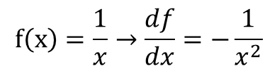
Backprop example With a neural network in mind
x0
w0
w0
2
w1
z = w0*x0+ w1*x1 + w2
x1
a = σ(z)
*
-2
-1
w2
x0
+
1
w1
-3
6
4
*
-2
x1
1
-1
0.37
1.37
0.73
+
*-1
exp
+1
1/x
???
1
-3
w2
$$f\left(x\right)=\frac{1}{x}→\frac{df}{dx}=−\frac{1}{x^{2}}$$
Example credit: https://cs231n.github.io/optimization-2/ , figure 2

Slide 33
Backprop example With a neural network in mind
x0
w0
w0
2
w1
z = w0*x0+ w1*x1 + w2
x1
a = σ(z)
*
-2
-1
w2
x0
+
1
w1
-3
6
4
*
-2
x1
1
-1
0.37
1.37
0.73
+
*-1
exp
+1
1/x
1* (-1/1.37²)
1
-3
w2
$$f\left(x\right)=\frac{1}{x}→\frac{df}{dx}=−\frac{1}{x^{2}}$$
Example credit: https://cs231n.github.io/optimization-2/ , figure 2

Slide 34
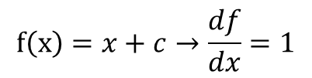
Backprop example With a neural network in mind
x0
w0
w0
2
w1
z = w0*x0+ w1*x1 + w2
x1
a = σ(z)
*
-2
-1
w2
x0
+
1
w1
-3
6
4
*
-2
x1
1
-1
0.37
1.37
0.73
+
*-1
exp
+1
1/x
???
-0.53
1
-3
w2
$$f\left(x\right)=x+c→\frac{df}{dx}=1$$
Example credit: https://cs231n.github.io/optimization-2/ , figure 2

Slide 35
Backprop example With a neural network in mind
x0
w0
w0
2
w1
z = w0*x0+ w1*x1 + w2
x1
a = σ(z)
*
-2
-1
w2
x0
+
1
w1
-3
6
4
*
-2
x1
1
-1
0.37
1.37
0.73
+
*-1
exp
+1
1/x
???
-0.53*1
-0.53
1
-3
w2
$$f\left(x\right)=x+c→\frac{df}{dx}=1$$
Example credit: https://cs231n.github.io/optimization-2/ , figure 2

Slide 36
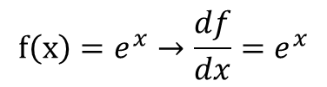
Backprop example With a neural network in mind
x0
w0
w0
2
w1
z = w0*x0+ w1*x1 + w2
x1
a = σ(z)
*
-2
-1
w2
x0
+
1
w1
-3
6
4
*
-2
x1
1
-1
0.37
1.37
0.73
+
*-1
exp
+1
1/x
-0.53*exp(-1)
-0.53
-0.53
1
-3
w2
$$f\left(x\right)=e^{x}→\frac{df}{dx}=e^{x}$$
Example credit: https://cs231n.github.io/optimization-2/ , figure 2

Slide 37
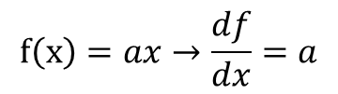
Backprop example With a neural network in mind
x0
w0
w0
2
w1
z = w0*x0+ w1*x1 + w2
x1
a = σ(z)
*
-2
-1
w2
x0
+
1
w1
-3
6
4
*
-2
x1
1
-1
0.37
1.37
0.73
+
*-1
exp
+1
1/x
???
-0.2
-0.53
-0.53
1
-3
w2
$$f\left(x\right)=ax→\frac{df}{dx}=a$$
Example credit: https://cs231n.github.io/optimization-2/ , figure 2

Slide 38
Backprop example With a neural network in mind
x0
w0
w0
2
w1
z = w0*x0+ w1*x1 + w2
x1
a = σ(z)
*
-2
-1
w2
x0
+
1
w1
-3
6
4
*
-2
x1
1
-1
0.37
1.37
0.73
+
*-1
exp
+1
1/x
-0.2*(-1)
-0.2
-0.53
-0.53
1
-3
w2
$$f\left(x\right)=ax→\frac{df}{dx}=a$$
Example credit: https://cs231n.github.io/optimization-2/ , figure 2

Slide 39
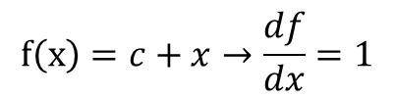
Backprop example With a neural network in mind
x0
w0
w0
2
w1
z = w0*x0+ w1*x1 + w2
x1
a = σ(z)
*
-2
-1
w2
x0
+
1
w1
-3
6
4
*
-2
1*0.2
x1
1
-1
0.37
1.37
0.73
+
*-1
exp
+1
1/x
0.2
-0.2
-0.53
-0.53
1
-3
w2
$$f\left(x\right)=c+x→\frac{df}{dx}=1$$
1*0.2
Example credit: https://cs231n.github.io/optimization-2/ , figure 2

Slide 40
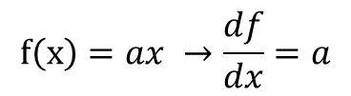
Backprop example With a neural network in mind
x0
w0
w0
2
w1
z = w0*x0+ w1*x1 + w2
0.2* (-1)
x1
a = σ(z)
*
-2
-1
w2
x0
0.2
0.2* 2
+
1
w1
-3
6
4
*
-2
0.2
0.2
x1
1
-1
0.37
1.37
0.73
+
*-1
exp
+1
1/x
0.2
-0.2
-0.53
-0.53
1
-3
w2
$$f\left(x\right)=ax →\frac{df}{dx}=a$$
0.2
Example credit: https://cs231n.github.io/optimization-2/ , figure 2

Slide 41
Backprop example With a neural network in mind
x0
w0
w0
2
w1
z = w0*x0+ w1*x1 + w2
-0.2
x1
a = σ(z)
*
-2
-1
w2
x0
0.2
0.4
+
1
w1
-3
6
-0.4
4
*
-2
0.2
0.2
x1
-0.6
1
-1
0.37
1.37
0.73
+
*-1
exp
+1
1/x
0.2
-0.2
-0.53
-0.53
1
-3
w2
$$f\left(x\right)=ax →\frac{df}{dx}=a$$
0.2
Example credit: https://cs231n.github.io/optimization-2/ , figure 2

Slide 42
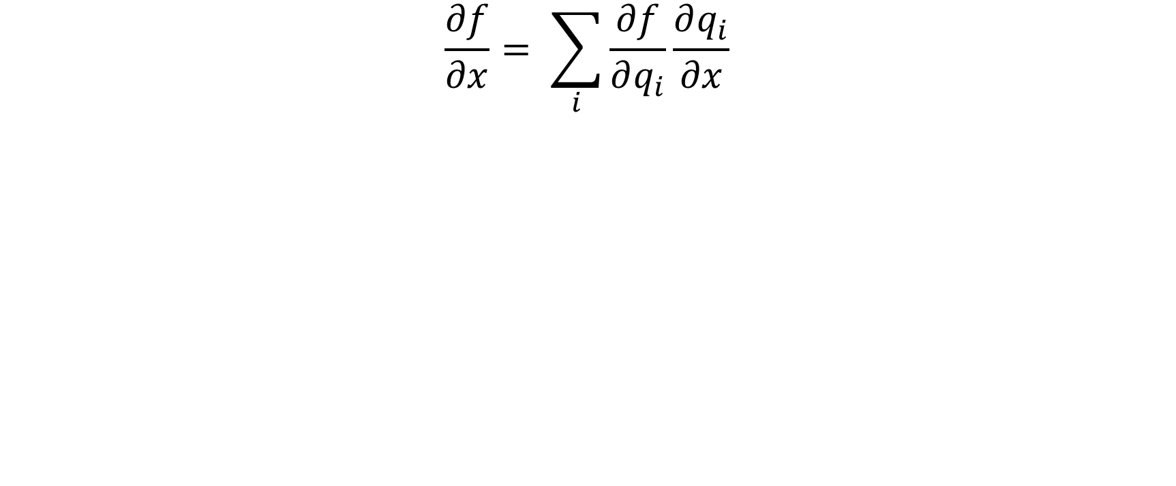
Multivariate chain rule
$$\frac{∂f}{∂x}= \sum_{i}{\frac{∂f}{∂q_{i}}\frac{∂q_{i}}{∂x}}$$
+

Slide 43
Patterns in backpropagation
Addition gate: gradient distributor
Multiplication gate: gradient switcher
Max gate: gradient router
a
*
b
+
c
*
d
max
e

Slide 44
The spelled-out intro to neural networks and backpropagation: building micrograd
Youtube lecture
https://www.youtube.com/watch?v=VMj-3S1tku0
Notebooks
https://github.com/karpathy/nn-zero-to-hero/tree/master/lectures/micrograd

Slide 45
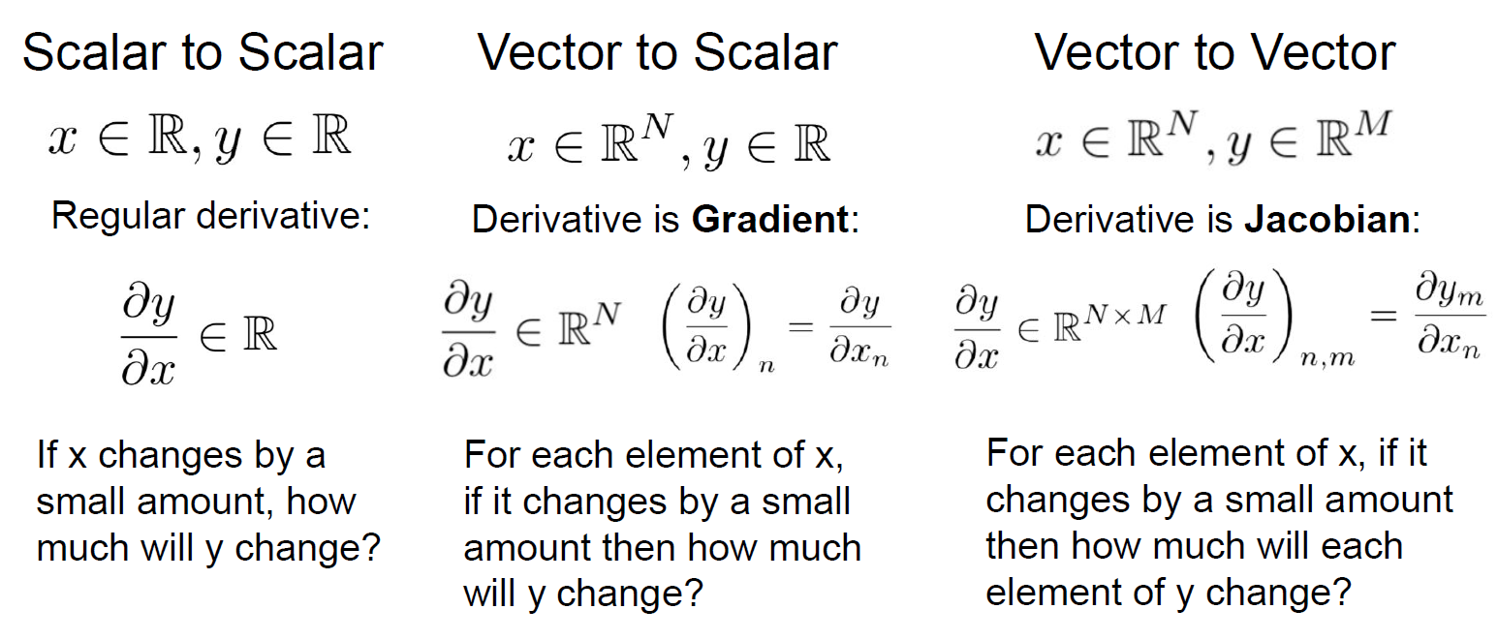
Back-propagation for vectors

Slide 46
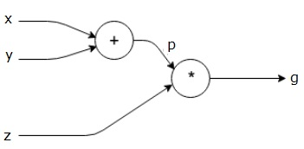
Forward/backward API
class ComputationalGraph():
… def forward(inputs): for node in topological_sort(self.nodes): # forward inputs through each node # (also cache these inputs) node.forward() return predictions
… def backward(loss): for node in reversed(topological_sort(self.nodes)): # backpropagation (apply chain rule) node.backward() return input_gradients

Slide 47
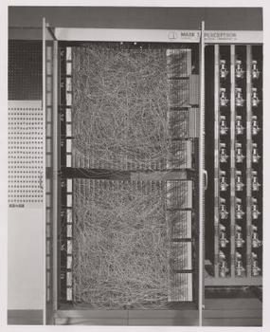
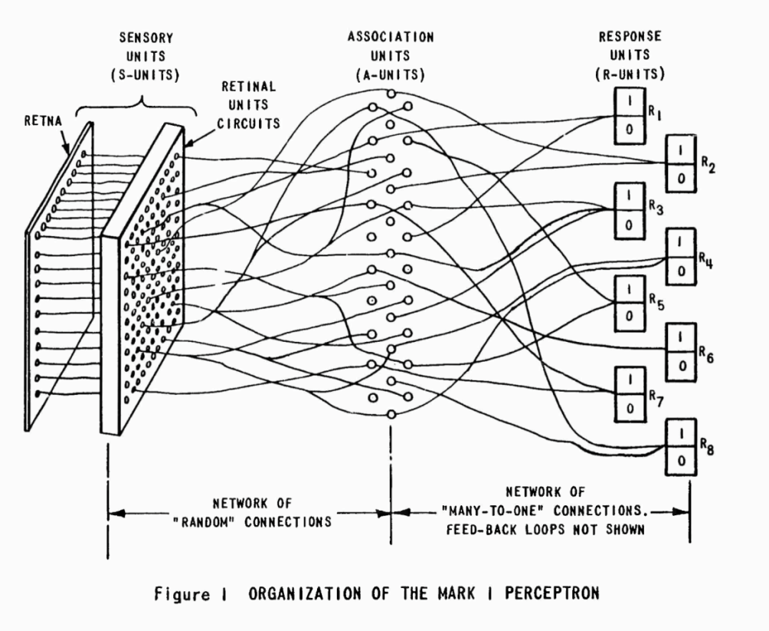
Mark I Perceptron machine: first implementation of the perceptron algorithm (~1957)
It was connected to a camera with 20×20 cadmium sulfide photocells to make a 400-pixel image
Weights were encoded in potentiometers, and weight updates during learning were performed by electric motors
Image source: https://en.wikipedia.org/wiki/Perceptron
https://www.youtube.com/watch?v=cNxadbrN_aI

Slide 48
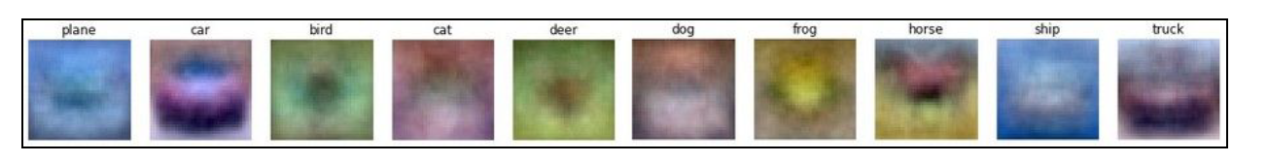
Neural networks
Neural network (multi layer perceptron, fully connected networks) :
Stack two (or more) linear classifiers on top of each other with a non-linear activation function in between
Linear unit
W1
Non-linearity
Linear unit
W2
Non-linearity
X
scores
Templates image source: http://cs231n.stanford.edu/
3072
200

Slide 49
Why do we need activation functions?
Layer 1:
Z1 = W1·X
Layer 2:
Z2 = W2·g(W1·X), where g is the activation function
What happens if we didn’t use a non-linearity?
Linear unit
W1
Non-linearity
Linear unit
W2
Non-linearity
X
scores

Slide 50
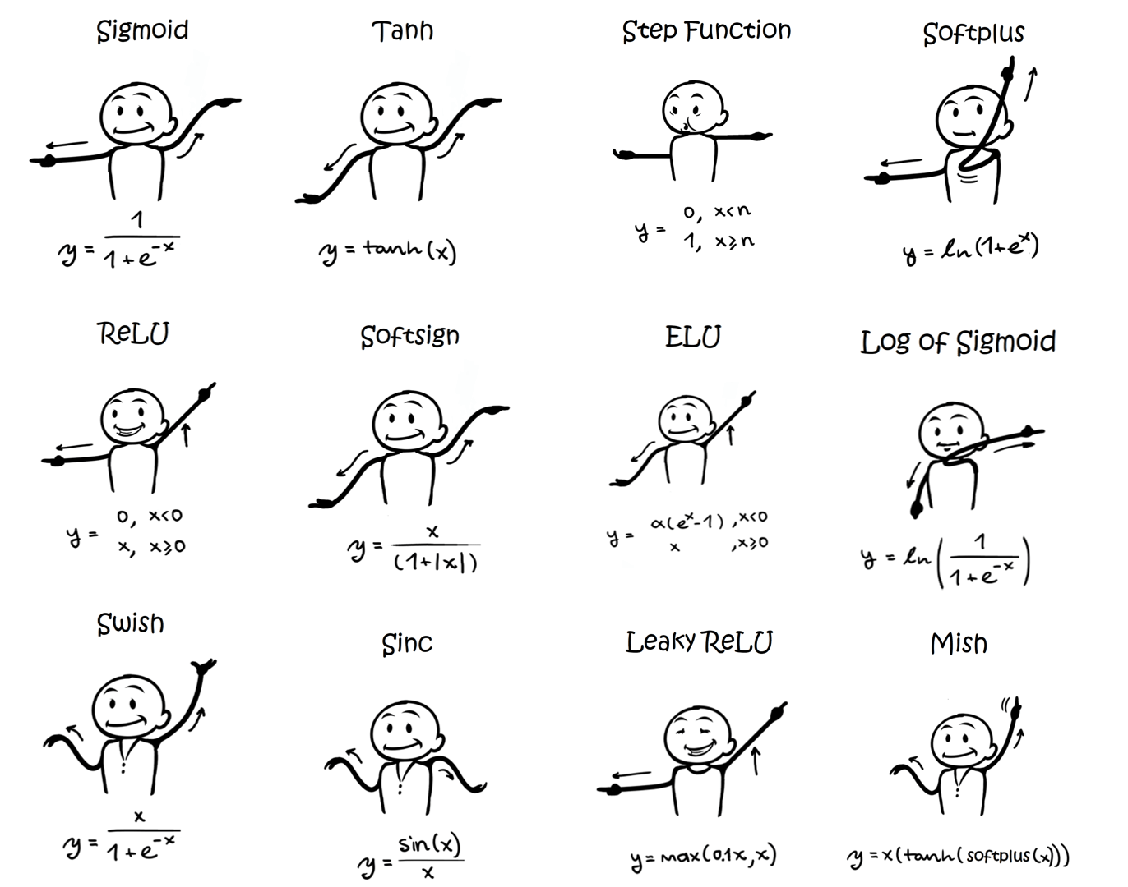
Activation functions
Two properties:
Differentiable
Non linear
Commonly used activation functions and their derivative
https://ml-cheatsheet.readthedocs.io/en/latest/activation_functions.html

Slide 51
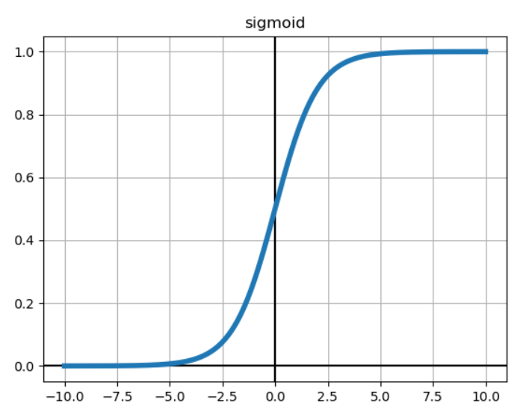
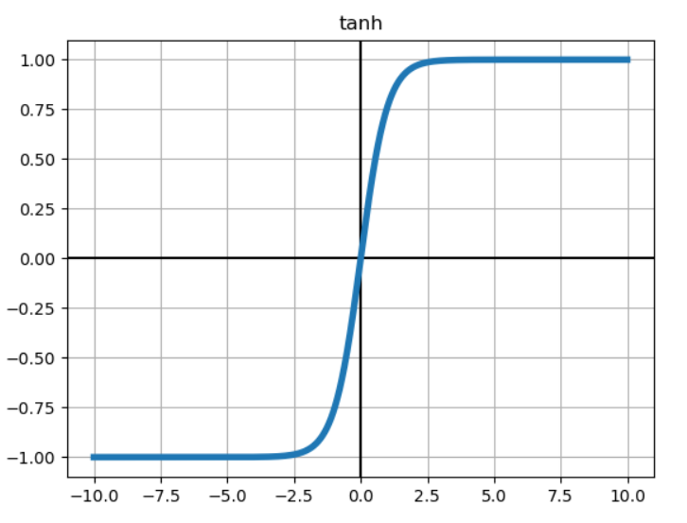
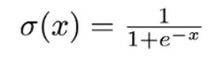

Activation functions

Slide 52




Activation functions

Slide 53



Activation functions
GELU
ELU

Slide 54



Neural networks
dendrites
output axon
w0x0
synapse
$$f(\sum_{i}^{ }{w_{i}x_{i}+b )}$$
w1x1
$$\sum_{i}^{ }{w_{i}x_{i}+b}$$
f
w2x2
cell body

Slide 55
Neural network and the brain
deeplearning.ai Course 1, Week 4: What does this have to do with the brain?
https://www.coursera.org/lecture/neural-networks-deep-learning/what-does-this-have-to-do-with-the-brain-obJnR
We should be more reserved about the brain analogies
There are actually many different types of biological neurons
Dendrites can perform complex non-linear operations
Complex connectivity patterns

Slide 56
torch.autograd
torch.autograd is PyTorch’s automatic differentiation engine that powers neural network training.
Specify requires_grad=True for tensors that your want autograd to track operations on
When calling .backward(), autograd calculates these gradients and stores them in the respective tensors’ .grad attribute.
https://colab.research.google.com/drive/1HlbodLDZiZYcG43BfMardWQfgKXRUStl?usp=sharing

Slide 57
Playground
https://playground.tensorflow.org/

Slide 58
Convolutions

Slide 59
Image convolutions
10 | 20 | 30 | 15 | 12
11 | 200 | 34 | 23 | 45
32 | 35 | 255 | 255 | 10
10 | 33 | 6 | 7 | 59
13 | 43 | 13 | 45 | 3
-1 | -1 | -1
0 | 0 | 0
1 | 1 | 1

Slide 60
Image convolutions
10 | 20 | 30 | 15 | 12
11 | 200 | 34 | 23 | 45
32 | 35 | 255 | 255 | 10
10 | 33 | 6 | 7 | 59
13 | 43 | 13 | 45 | 3
-1 | -1 | -1
0 | 0 | 0
1 | 1 | 1
262
-10 – 20 – 30 + 32 + 35 + 255 = 262

Slide 61
Image convolutions
10 | 20 | 30 | 15 | 12
11 | 200 | 34 | 23 | 45
32 | 35 | 255 | 255 | 10
10 | 33 | 6 | 7 | 59
13 | 43 | 13 | 45 | 3
-1 | -1 | -1
0 | 0 | 0
1 | 1 | 1
262 | 480
-20-30-15+35+255+255 = 480

Slide 62


Convolutional filters What do you think is the effect of the following filters?
$$\left[\begin{matrix}0 & 0 & 0 \\ 0 & 1 & 0 \\ 0 & 0 & 0\end{matrix}\right]$$
$$\left[\begin{matrix}0 & 0 & 0 \\ 1 & 0 & 0 \\ 0 & 0 & 0\end{matrix}\right]$$

Slide 63





Convolutional filters What do you think is the effect of the following filters?
$$\frac{1}{16}\left[\begin{matrix}1 & 2 & 1 \\ 2 & 4 & 2 \\ 1 & 2 & 1\end{matrix}\right]$$

Slide 64





Convolutional filters What do you think is the effect of the following filters?
$$\left[\begin{matrix}1 & 0 & −1 \\ 2 & 0 & −2 \\ 1 & 0 & −1\end{matrix}\right]$$
$$\left[\begin{matrix}1 & 2 & 1 \\ 0 & 0 & 0 \\ −1 & −2 & −1\end{matrix}\right]$$

Slide 65


Kernels learned from AlexNet first convolutional layers
Gabor filters

Slide 66
Convolutional neural networks

Slide 67


Understanding the visual cortex
Nobel Prize for Physiology or Medicine in 1981:
David Hubel and Torsten Wiesel
Simple cells:
orientation, position
Complex cells:
orientation, motion, direction
“Hypercomplex” cells:
orientation, motion, direction, length
Hubel and Wiesel, 1959
https://www.youtube.com/watch?v=IOHayh06LJ4&ab_channel=PaulLester
Image source: https://www.researchgate.net/publication/335707980_Understanding_Neural_Networks_via_Feature_Visualization_A_Survey

Slide 68

Understanding the visual cortex
Nearby cells in the cortex represented and processed nearby regions in the visual field
Hubel and Wiesel hypothesized that the visual cortex can be described by a hierarchical organization of simple cells that fed into complex cells which have more complicated activations and can form higher level representations
https://peterkim95.github.io/jekyll/update/2017/08/29/introspectiveness-of-nn/

Slide 69


Gradient-Based Learning Applied to Document Recognition, Yann LeCun, Leon Bottou, Yoshua Bengio, and Patrick Haffner, 1998
1989 – the original form of LeNet

Slide 70
Deep Big Simple Neural Nets Excel on Handwritten Digit Recognition Dan Ciresan, 2010
One of the very fist implementations of GPU Neural nets
forward and backward pass implemented of an artificial neural network (up to 9 layers) implemented on an NVIDIA GTX 280 graphic processor

Slide 71

ImageNet Classification with Deep Convolutional
Neural Networks, Alex Krizhevsky, Ilya Sutskever, Geoffrey E. Hinton
2012

Slide 72
Convolutional neural networks

Slide 73

Convolutional layers
Preserve the spatial information
Convolve the filter over the entire input volume
The filter has the same depth as the input
filter
5x5x3
Input volume
32x32x3
Activation map
28x28x1

Slide 74
Convolutional layers
Preserve the spatial information
Convolve the filter over the entire input volume
The filter has the same depth as the input
At each position in the input volume:
Multiply (element-wise, across all channels) the filter and a small patch (5x5x3) in this input volume and add a bias term
filter
5x5x3
Input volume
32x32x3
Activation map
28x28x1

Slide 75
Convolutional layers
Preserve the spatial information
Convolve the filter over the entire input volume
The filter has the same depth as the input
k filters
Input volume
32x32x3
k activation maps
28x28x1

Slide 76
Convolutional layers
Neurons in an activation map:
Each neuron is connected to a small region in the input
All of neurons in the activation map share parameters
Receptive field of a neuron
k filters → k different neurons all looking at the same region in the input volume
k activation maps
28x28x1

Slide 77

https://medium.com/@chriskevin_80184/feature-maps-ee8e11a71f9e
https://www.youtube.com/watch?v=AgkfIQ4IGaM

Slide 78
Convolutional layers Stride
Stride – the amount by which the filter shifts
Stride 1

Slide 79
Convolutional layers Stride
Stride – the amount by which the filter shifts
Stride 2

Slide 80
Convolutional layers Padding
0 | 0 | 0 | 0 | 0 | 0 | 0
0 |  |  |  |  |  | 0
0 |  |  |  |  |  | 0
0 |  |  |  |  |  | 0
0 |  |  |  |  |  | 0
0 |  |  |  |  |  | 0
0 | 0 | 0 | 0 | 0 | 0 | 0
Convolve an input of spatial size 7x7 with a 3x3 filter : output spatial size?
Convolve an input of spatial size 7x7 with a 3x3 filter, and applying 0 padding to the input: output spatial size?
To preserve size spatially:
CONV layers with stride 1, filters of size FxF, and zero-padding with (F-1)/2
padding: 1

Slide 81
Why convolutions
Parameter sharing
A feature detector that’s useful in one part of an image is probably useful in other parts of the image
Translation invariance
Sparsity of connections
The output volume depends only on a small (filter size) subset of the input volume

Slide 82


Convolutional layers
($W_{I}$ , $H_{I}$, $D_{I}$ ) ($W_{O}$ , $H_{O}$, $D_{O}$ )
$D_{I}$ = filter depth
$W_{I}$ – input width, $W_{O}$ – output width
$H_{I}$ – input height, $H_{O}$ – input height
F – filter size
P – padding
S - stride
$$W_{o}=\frac{W_{I} −F+2P}{S}+1$$
$$H_{o}=\frac{H_{I} −F+2P}{S}+1$$

Slide 83

Padding: “same” or “valid”

Slide 84
Pooling layers
Operate independently over each channel in the input
Reduces the input size, creating smaller (and more manageable) representations
Common pooling layers:
max pooling: takes the maximum value within each “patch” in the feature map
average pooling: takes the average value of each “patch” in the feature map
It does not contain any learnable weights

Slide 85

Pooling layers
Operates independently over each channel
Pooling – reduces spatial dimension

Slide 86



Pooling layers Examples
Max pooling
Avg pooling

Slide 87
Pooling layers Example: max pooling layer, F 2, stride 1
1 | 3 | 6 | 6
20 | 9 | 8 | 4
2 | 1 | 4 | 5
1 | 12 | 13 | 10
20 | 9 | 8
20 | 9 | 8
12 | 13 | 13

Slide 88
Pooling layers Example: max pooling layer, F 2, stride 2
1 | 3 | 6 | 6
20 | 9 | 8 | 4
2 | 1 | 4 | 5
1 | 12 | 13 | 10
20 | 8
12 | 13

Slide 89
Pooling layer
Parameters
Filter size (spatial extent): F
Stride: S
Input: W_{I} × H_{I} × D
Output: W_{O} × H_{i} × D
It has no learnable parameters
$$W_{o}=\frac{W_{I} −F}{S}+1$$
$$H_{o}=\frac{H_{I} −F}{S}+1$$

Slide 90


Slide 91


Slide 92
Fully connected layers
They don’t preserve spatial information
Linear unit followed by a linearity
Just in regular NN, contain several neurons that are connected to the entire input volume
Each neuron “sees” the entire input volume
f(W·X + b)
1
1
f – activation function
W – weight matrix (D_{O} × D_{I})
b – bias vector
D_{I}
D_{O}

Slide 93


Slide 94
If we have an input volume of 27x27x5, what will be size of this volume if we apply a padding of 2?
How many parameters (including the bias) does a convolutional layer with 10 filters of size 5x5 have?
How many parameters (including the bias) does a convolutional layer with 10 filters of size 5x5 have if the input size is 32x32x3? What if we use a stride of 2?
Given an input volume that is 63x63x16 that is convolved with 32 filters that are each 7x7, using a stride of 2 and no padding. What is the output volume?
Given a RGB image of size 300x300, and you use a classical neural network with the first hidden layer of 100 neurons (each one fully connected to the input). How many parameters does this hidden layer have?

Slide 95

Typical neural network architecture
Image source: https://medium.com/@RaghavPrabhu/understanding-of-convolutional-neural-network-cnn-deep-learning-99760835f148

Slide 96
Typical neural network architecture
Several CONV, POOL and FC layers stacked together
[CONV-ReLU-POOL]*N – [FC]*K – softmax
Recent neural networks change this paradigm
The trend is to reduce the filter sizes and to increase the depth of the networks
Another trend is to avoid using POOL and FC layers, and use only CONV layers

Slide 97

Alexnet example
“AlexNet input starts with 227 by 227 by 3 images. And if you read the paper, the paper refers to 224 by 224 by 3 images. But if you look at the numbers, I think that the numbers make sense only of actually 227 by 227.”

Slide 98
What did we learn today?
Backpropagation
Forward pass, backward pass
Artificial neural networks
Input, output, hidden layers
Activation functions
Image convolutions
Convolutional neural networks

Slide 99
Recommended resources
Spelled out intro to backpropagation: https://www.youtube.com/watch?v=VMj-3S1tku0
Deeplearning AI: Course 1: deeplearning.ai Neural networks fundamentals
http://cs231n.stanford.edu/
https://medium.com/@karpathy/yes-you-should-understand-backprop-e2f06eab496b
https://developer.nvidia.com/blog/deep-learning-nutshell-core-concepts/#activation-function
Back-propagation calculus explained:
https://www.youtube.com/watch?v=IHZwWFHWa-w&t=347s&ab_channel=3Blue1Brown
https://www.youtube.com/watch?v=Ilg3gGewQ5U&ab_channel=3Blue1Brown
https://www.youtube.com/watch?v=tIeHLnjs5U8&ab_channel=3Blue1Brown

